Slide 1

SPOTIFY ANALYSIS- 2025
Submitted By
NANDANA CV
Data Analytics

Slide 2

INTRODUCTION
This Power BI project analyzes a music streaming dataset to understand user behavior.
It includes data on demographics, subscription types, and listening habits.
The dashboard presents insights using interactive and clear visualizations.
These insights help identify trends and improve user experience and performance.

Slide 3
OBJECTIVES
Understand user distribution by gender, age, and country
Analyze average listening time of users
Study songs per day vs skip rate
Compare free and premium users
Identify how device type influences listening behavior

Slide 4
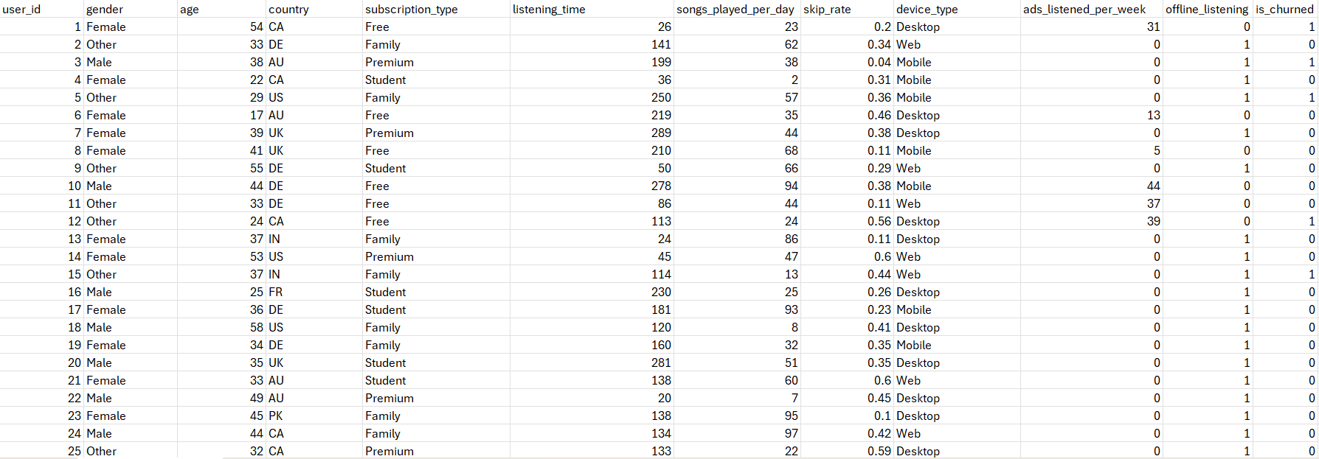
DATASET

Slide 5
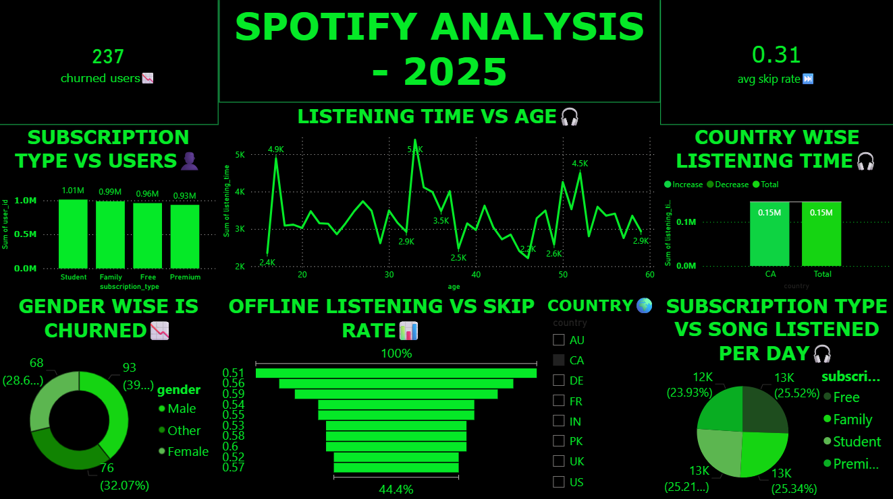

Slide 6
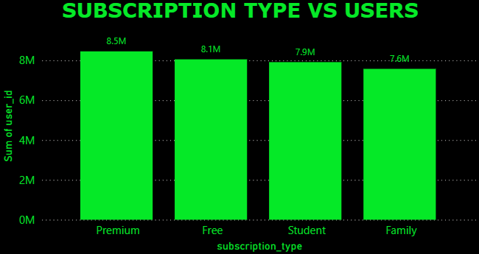
BAR CHART
Compare values between categories
Premium has the highest number of users (~8.5M)
Free plan follows closely (~8.1M)
Student and Family have slightly fewer users

Slide 7
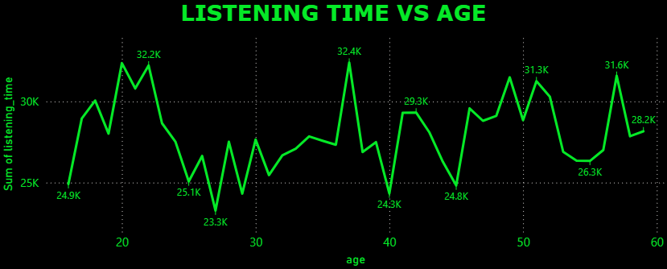
LINE CHART
Shows trends over time
Listening varies by age
High: early 20s, mid-30s, early 50s
Low: late 20s, around 40

Slide 8
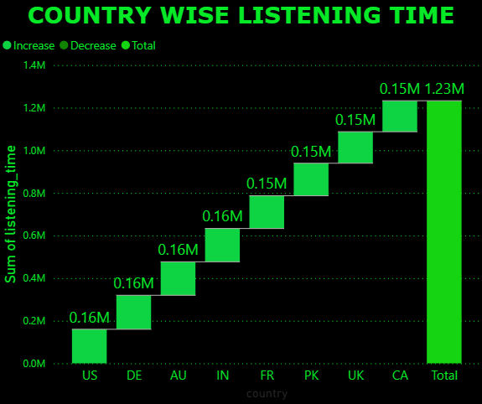
WATERFALL CHART
Show step by step change to final value
Listening time:-
All countries positive
High: US, DE, AU (~0.16M)
Low: Others (~0.15M)
Total: ~1.23M

Slide 9
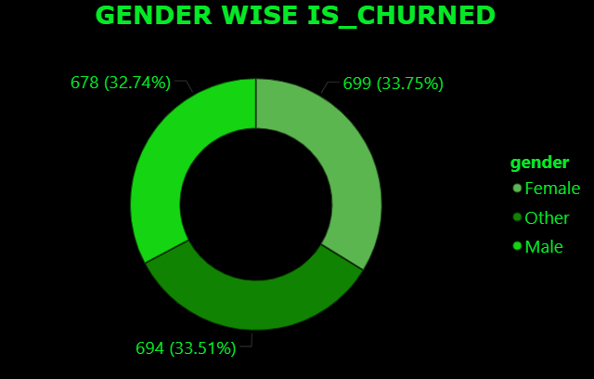
DONUT CHART
Churn nearly equal across genders
High: Female (~33.75%)
Mid: Other (~33.51%)
Low: Male (~32.74%)
Diff: Minimal

Slide 10
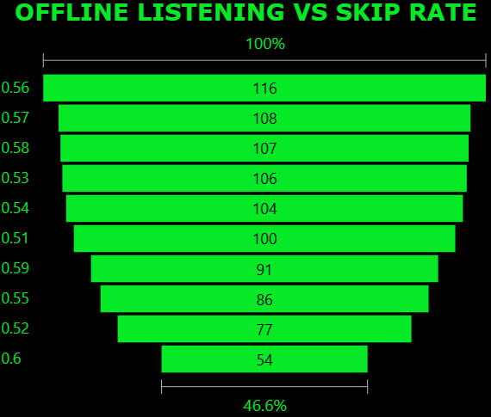
FUNNEL CHART
Shows stage wise decrease
Offline listening ↓ skips
Low engagement → high skips
Most users = mid level engagement
Offline listening reduces skipping

Slide 11
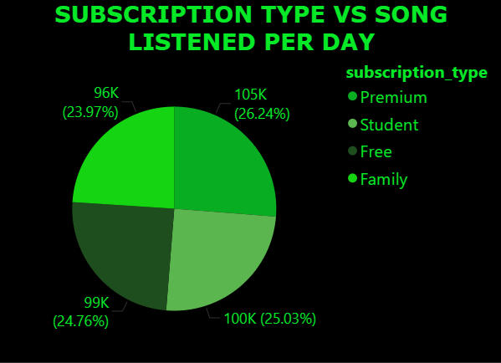
PIE CHART
Engagement similar across subscription types
Premium slightly higher
Family, Student, Free ≈ similar
Overall engagement consistent across users

Slide 12
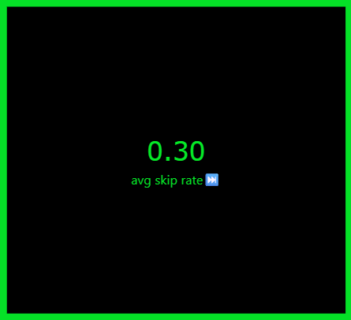

KPI CARDS
AVG SKIP RATE
Moderate disengagement
~30% songs skipped
Needs better recommendations
CHURNED USERS
Retention issue
2071 users churned
Needs better engagement & loyalty

Slide 13

SLICER
Filters data interactively
Covers key markets (AU, US, UK, IN)
Allows flexible regional filtering
Helps analyze geographic trends

Slide 14
FINDINGS
A total of 2071 users have churned, indicating a user drop.
The average skip rate is 30%, showing reduced engagement.
Premium users have higher listening activity than others.
Users aged 30–40 are the most active listeners.

Slide 15
CONCLUSION
Balanced engagement across all user segments.
Skip rate strongly influences user satisfaction and experience.
Premium users show higher retention, staying longer than free users.
Users aged 30–40 contribute the most to overall platform usage

Slide 16
THANK YOU

